Slide 1
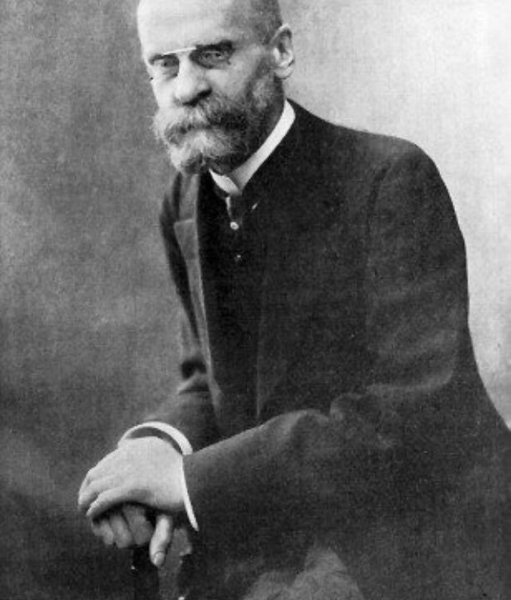
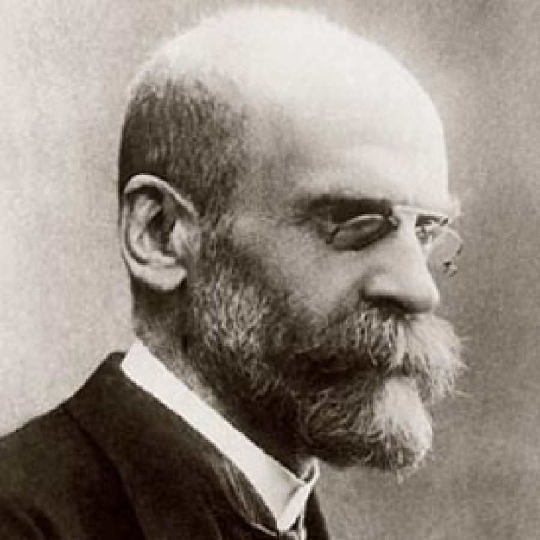
EMILE DURKHEIM (1858-1917)

Slide 2
EMILE DURKHEIM (1858-1917)
Born at Epinal in Loraine, French; on April 15, 1858.
Attended Ecole Normale Superieure, the traditional training ground for the intellectual elite of France.
Son of a rabbi and descending from a long line of rabbis, he decided to follow the family tradition and become a rabbi.
Studied Hebrew, the Old Testament, and the Talmud
Had a mystical experience under the influence of a Catholic woman teacher, that led to an interest in Catholicism.

Slide 3
The Work
The overall doctrine: the study of society must eschew reductionism
Social phenomena must be viewed as sui generis.
Rejecting biologistic or psychologistic interpretations of social problems.
Social phenomena are "social facts" and these are the subject matter of sociology.

Slide 4
Social Facts
They consist of manners of acting, thinking and feeling external to the individual, which are invested with a coercive power by virtue of which they exercise control over him.
A social fact is any way of acting, whether fixed or not, capable of exerting over the individual an external constraint.
Examples of social facts include rules of professional conduct, religious observances, the family, public morality, social institutions like political parties, educational institutions, the economy, health, etc.

Slide 5
Characteristics of Social Facts
There are four major characteristics of social facts:
They have distinctive social characteristics and determinants which are not amenable to explanation on either the biological or psychological level
They are external to the individual
They endure through time outlasting any set or group of individuals
They are endowed with coercive power, imposing themselves upon him, independent of his will.

Slide 6
Methodology
His methodology consists of formulating rules to help single out social facts.
First, in observing social facts preconceptions must be eradicated.
Second, the subject matter should be social facts.
Comparative method is the method suitable to sociology. To him causation is a necessary relation between a prior and a subsequent state of phenomena and can be determined only by comparing the two states.
There is also the need to engage in functional analysis. This entails the examination of the function of the social fact to maintain the social whole.

Slide 7
Social Solidarity
This is a classic study of social solidarity that is what holds society together and keeps it from disintegrating, which was developed in his book, ‘The Division of Labour in Society’ (1893).
He sought in this work to explain division of labour from a societal perspective.
He distinguished between mechanical and organic solidarity.

Slide 8
Mechanical Solidarity
Solidarity based on sameness, commonness, likeness, similarities.
Individual differences are minimized and the members of society are much alike in their devotion to the common goal.
Thus, resemblance in beliefs and practices, occupation, language, dressing, food, housing, etc. as seen in villagual, ancient, pre-modern, rural, pre-industrial, archaic societies.
Violation of the collective conscience is met with harsh punishment.

Slide 9
Organic Solidarity
Solidarity based on differences, division of labour and specialization.
Increasing differentiation comes with increasing interdependence as parts of an organism inter-depend for the survival of the whole.
Thus, we have specialist doctors, farmers, labourers, builders, drivers, teachers, etc. each one of these categories of people has a special domain that only he or she is officially sanctioned to perform.
Thus, the physician buys his meat from the butcher and the butcher seeks medical care from the physician.
There is division of labour and specialization which naturally call for interdependence (solidarity).

Slide 10
The Individual and Society
Men were creatures whose desires were unlimited. Unlike other animals, they are not satiated when their biological needs are fulfilled.
"The more one has, the more one wants: insatiability
Desires can only be held in check by external controls, that is, by societal control.
When social regulations break down, the controlling influence of society on individual propensities is no longer effective and individuals are left to their own devices.
Such a state of affairs Durkheim calls anomie,
Individual desires are no longer regulated by common norms and where, as a consequence, individuals are left without moral guidance in the pursuit of their goals.

Slide 11
Suicide
There are no societies in which suicide does not occur.
This indicates that suicides may be considered a "normal," that is, a regular, occurrence.
However, sudden spurts in the suicide rates of certain groups or total societies are "abnormal" and constitute a disintegration of forces at work in a social structure.
Distinguished types of suicide according to the relation of the actor to his society.

Slide 12
Suicide: Level of Integration
When people become "detached from society," when they are thrown upon their own devices and loosen the bonds that previously had tied them to their fellow, they are prone to
Egoistic/individualistic
Altruistic

Slide 13
Egoistic Suicide
The people who have lost group attachment, they commit suicide because of frustration.
So egoistic suicide implies that the person commits suicide when he thinks primarily of himself when he is not integrated into the social group.
E.g. catholic vs. protestants, married vs. unmarried

Slide 14
Altruistic Suicide
But in case of altruistic suicide, social integration is too strong.
More generally, the persons committing altruistic suicide feel that it is their duty to do so.
E.g. Army officers

Slide 15
Suicide: Level of Regulation
When the societal regulation is too high or too low, it leads to
Anomic suicide
Fatalistic

Slide 16
Anomic Suicide
This type of suicide is more likely to occur when regulation is too weak. It is caused due to extreme frustration of an individual.
Anomic is a chronic state of affairs in the modern socio-economic system. It occurs during industrial or financial crises. He showed that there was a high rate of anomic suicide among the wealthy as well as divorced persons as most of them are not in a positive to adjust themselves to violent changes in their life system and set up.

Slide 17
Fatalistic Suicide
It is more likely to occur when regulation is excessive.
Durkheim described that persons more likely commit fatalistic suicide whose future is pitilessly blocked and whose passions are violently chocked.

Slide 18
Religion
A religion is a unified system of beliefs and practices relative to sacred things, that is to say, things set apart and forbidden--beliefs and practices which unite in one single moral community called a Church, all those who adhere to them.
Religious phenomena emerge in any society when a separation is made between the sphere of the profane and the sphere of the sacred
An object is intrinsically neither sacred nor profane.
The wine at mass has sacred ritual significance to the extent that it is considered by the believer to symbolize the blood of Christ; in this context it is plainly not a beverage.

Slide 19
Functions of Religion
Durkheim did not follow Saint-Simon and Comte in attempting to institute a new humanitarian cult.
Durkheim classified four major functions of religion as
Disciplinary,
Cohesive,
Vitalizing, and
Euphoric social forces.

Slide 20
Crime and Punishment
Crime is normal in that no society could enforce total conformity to its injunctions, and if society could, it would be so repressive as to leave no leeway for the social contributions of individuals.
Deviance from the norms of society is necessary if society is to remain flexible and open to change and new adaptations

Slide 21
Durkheim identified indirect functions that are no less important. Crime and punishment together bring about
  Social change
  Social unity
  Occupation
  Income.
However, beyond a certain level (10% plus) crime renders a society pathological.

